Slide 1
Leetcode 演練

Slide 2
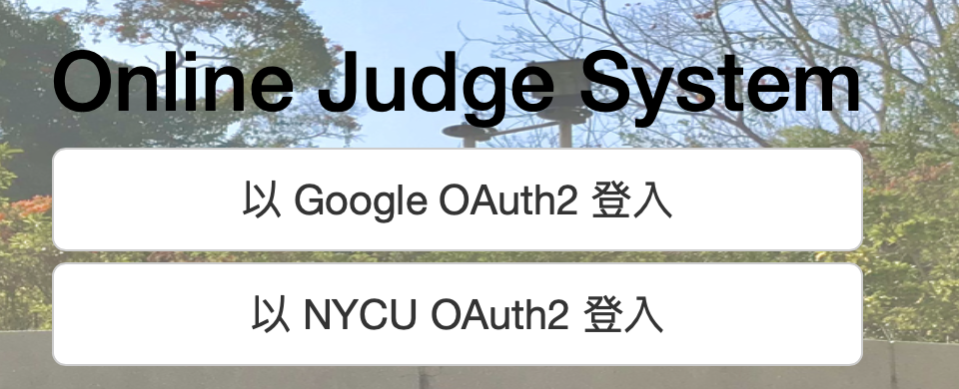
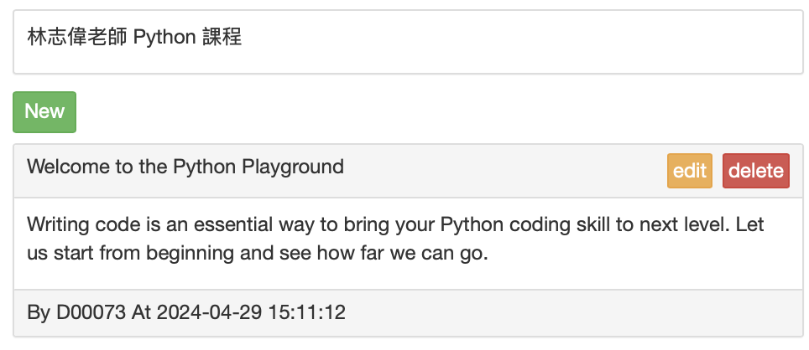
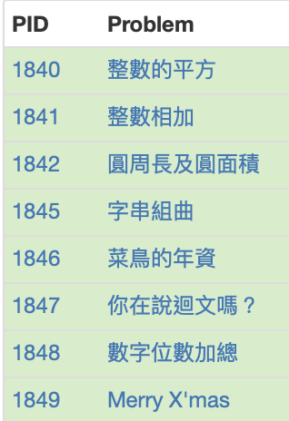
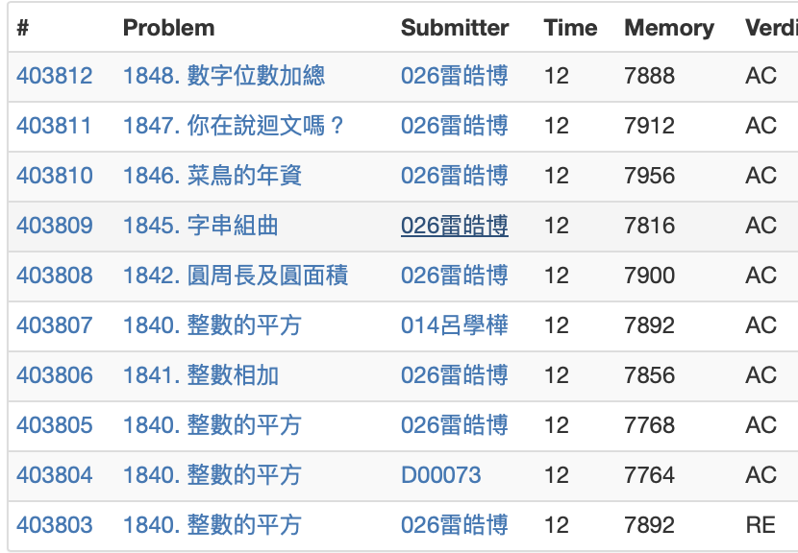
Our LeetCode On-line Judge System
Python Class On-line Judge System – Formosa OJ
https://formosa.oj.cs.nycu.edu.tw/signin/
Read input method
# of data items | Get input
One line string | my_str = input()
One number | n = int(input())
Fixed number | a, b = map(int, input().split())
Not fixed number | x = list(map(int, input().split()))
Google 登入顯示中文姓名
NYCU登入顯示學號

Slide 3
BACKUP

Slide 4
數字位數加總
題目：將一個整數各個位數相加
測試資料
input | output
0 | 0
5 | 5
45 | 9
263 | 11
9876 | 30
Notes:
# def add_digits(n):
# sum = 0
# while n != 0:
# sum += n % 10
# n = n //10
# return sum
# def add_digits(n):
# a = sum(list(map(int, list(str(n)))))
# return a
# def add_digits(n):
# foo = list(str(n))
# sum = 0
# for i in foo:
# sum += int(i)
# return sum
print(add_digits(0))
print(add_digits(5))
print(add_digits(45))
print(add_digits(263))
print(add_digits(9876))

Slide 5




聖誕樹
#方法一: 做一個四層的聖誕樹
N = 4
#印星星
for i in range(N):
print(f"{'*'*(2*i+1):^{2*N-1}}")
#印直槓
for j in range(N-1):
print(f"{'|':^{2*N-1}}")
利用 for loop 印出 四層的聖誕樹(N=4)
N層的星號和N-1層的直槓
每一層的星號數為 2i+1個
星星和直槓要置中
星號層可以是 2N-1長度的置中 or 前置 N-i-1個空格
直槓層可以是 2N-1長度的置中 or 前置 N-1個空格
i =0
i =0
i =1
i =1
N=1
i =2
N=2
i =3
N=3
N=4
#方法二: 做一個四層的聖誕樹
N = 4
#印星星
for i in range(N):
print(' '*(N-i-1) + f"{'*'*(2*i+1)}")
#印直槓
for j in range(N-1):
print(' '*(N-1) + '|')
Notes:
for i in range(1, 10):
for j in range(1, 10):
print(j, 'x', i, '=', j*i, end=' ')
print()

Slide 6
找質數
找出20內的質數.(大於1的自然數中，除了1和該數自身外，無法被其他自然數整除的數)
先試試看某一個數是不是質數 (10是不是質數)
設計一個 2 ~ 20 的迴圈, 將每一個數都用1的方式檢查一下
num = 10
is_Prime = True
for i in range(2, num):
if num%i == 0:
is_Prime = False
if is_Prime:
print(f'{num} is Prime')
for num in range(2,21):
is_Prime = True
for i in range(2, num):
if num%i == 0:
is_Prime = False
if is_Prime:
print(f'{num} is Prime')

Slide 7
n 階乘
n! 階乘代表 1 * 2 * 3 ... * n 的乘積，請用 Python 程式實現 n! 計算。
讓使用者可以自行輸入一個數字 n，請檢查 n 是否為合法數字否則回傳錯誤訊息 (相關函數 .isnumeric())
利用程式計算 n! 的結果並且印在畫面上
通過以下測試
使用者輸入 4, 系統在畫面上輸出 24
使用者輸入 a, 系統在畫面上輸出 '輸入錯誤'

Slide 8
猜密碼
猜密碼，最多猜五次
#若猜錯五次, 則跳離迴圈
secret = 'p@ssw0rd'
max_tries = 5
guess = input('your secret: ')
tries = 1
while guess != secret:
print('Your guess is wrong and you tried ' + str(tries) + ' times')
if tries == max_tries:
print('You ran out of tries')
break
guess = input('your secret: ')
tries += 1
# end game: right guess or over max tries
if (tries <= max_tries) and (guess == secret):
print('You got it')
Notes:
for i in range(1, 10):
for j in range(1, 10):
print(j, 'x', i, '=', j*i, end=' ')
print()

Slide 9
#1026 判斷等比數列
題目：給你一個數列，請判斷是否為等比數列
測試資料
input | output
3 9 27 | True
1 4 16 | True
3 6 18 | False
3 | False
2 4 8 16 32 | True
Notes:
def is_geometric_sequence(lst):
if len(lst) <= 1:
return False
i = 0
while i < len(lst) - 2:
if (lst[i + 1] / lst[i]) != (lst[i + 2] / lst[i+1]):
return False
i += 1
return True
print(is_geometric_sequence([3, 9, 27]))
print(is_geometric_sequence([1, 4, 16]))
print(is_geometric_sequence([3, 6, 18]))
print(is_geometric_sequence([3]))
print(is_geometric_sequence([2, 4, 8, 16, 32]))

Slide 10
#1027 信用卡號驗證
題目：輸入一個信用卡卡號，16 碼，每 4 碼以 - 做為分隔，若是信用卡不合法，請輸出 INVALID，否則輸出信用卡的發卡行，只會有 VISA 與MASTER_CARD 這兩種結果
測試規則
從左邊算起來的第一個數字為發卡行，Master Card 是 5 開頭，Visa 是 4，JCB 則是 3
前 15 位數經過加權後加總，會得出一個數字，先把這數字除以 10 取餘數，如果結果是 0，那檢查碼就是 0，否則就是用 10 減去之後的結果
權重的部分：左邊數起奇數位是 2，偶數位是 1
若是在計算的過程中某一位數加權後的結果比 10 大，那請減去 9
測試資料: 信用卡卡號產生器 https://saijogeorge.com/dummy-credit-card-generator/
input | output
5412-3456-7890-1232 | MASTER_CARD
4886-8332-2871-9865 | VISA_CARD
4888-8332-2871-9865 | INVALID
位數 | 1 | 2 | 3 | 4 | 5 | 6 | 7 | 8 | 9 | 10 | 11 | 12 | 13 | 14 | 15
值 | 5 | 4 | 1 | 2 | 3 | 4 | 5 | 6 | 7 | 8 | 9 | 0 | 1 | 2 | 3
權重 | 2 | 1 | 2 | 1 | 2 | 1 | 2 | 1 | 2 | 1 | 2 | 1 | 2 | 1 | 2
權值 | 1 | 4 | 2 | 2 | 6 | 4 | 1 | 6 | 5 | 8 | 9 | 0 | 2 | 2 | 6
(權值加總是58), (58 % 10是8), (檢查碼 10-8 = 2), (若第16個位數不是2，則是錯誤的卡號)
Notes:
# crd id: 1234-5678-9ABC-DEFX (X: checksum 檢查碼)
# python: 0123-4567-89AB-CDEX
def convert_id(id):
id_no_dash = id.replace('-','')
id_1 = id_no_dash[0]
id_first_15 = id_no_dash[0:15]
id_last = id_no_dash[15]
# print(id_1, id_first_15, id_last)
return (id_1, id_first_15, id_last)
def calculate_weight(id_first_15):
sum = 0
for count, value in enumerate(id_first_15):
if count % 2 == 0:
if int(value) * 2 >= 10:
sum = sum + int(value) * 2 - 9
else:
sum = sum + int(value) * 2
else:
sum = sum + int(value)
return sum
def is_valid_credit_card(id):
(id_1, id_first_15, id_last) = convert_id(id) #id_15 = 541234567890123, id_check = 2
weight_value = calculate_weight(id_first_15) % 10
if weight_value == 0:
checksum = 0
else:
checksum = 10 - weight_value
if checksum == int(id_last) and id_1 == '5':
return 'MASTER_CARD'
if checksum == int(id_last) and id_1 == '4':
return 'VISA_CARD'
if checksum != int(id_last):
return 'INVALID'
card_1 = '5412-3456-7890-1232'
card_2 = '4886-8332-2871-9865'
card_3 = '4888-8332-2871-9865'
print(is_valid_credit_card(card_1)) # MASTER_CARD
print(is_valid_credit_card(card_2)) # VISA_CARD
print(is_valid_credit_card(card_3)) # INVALID

Slide 11
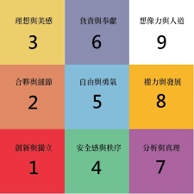
#1028 生命靈數
題目：以上面川普的生日 1946-06-14 為例，就是 1+9+4+6+0+6+1+4 = 31, 而我們把這個結果的每個位數再次做相加：3+1 = 4
生命靈數 4 的人的性格是「能幹的領導者，但冷酷沒有人情味」
input | output
1991 11 07 | 2
1946 06 14 | 4
1954 09 21 | 4
1984 01 08 | 4
Notes:
def addition(num_str):
sum = 0
for ch in num_str:
sum = sum + int(ch)
return sum
def calculate_life_num(b_day):
b_day_num = b_day.replace(' ','')
life_num = addition(b_day_num)
while life_num >= 10:
life_num = addition(str(life_num))
return life_num
B1 = '1991 11 07' #2
B2 = '1946 06 14' #川普, 4
B3 = '1954 09 21'
#安倍晉三, 4
B4 = '1984 01 08'
#金正恩, 4
print(calculate_life_num(B1))
print(calculate_life_num(B2))
print(calculate_life_num(B3))
print(calculate_life_num(B4))

Slide 12
#1029 加減乘除
題目：給兩個數字以及一個運算符號（只會是加減乘除其中一個）求出計算結果
input | output
6 * 2 | 12
6 + 2 | 8
6 - 2 | 4
6 / 2 | 3
Notes:
def split_exp(expression):
A = int(expression.split()[0])
B = int(expression.split()[2])
OP = expression.split()[1]
if OP == '+':
return A + B
if OP == '-':
return A - B
if OP == '*':
return A * B
if OP == '/':
return A // B
Q1 = '6 * 2'
Q2 = '6 + 2'
Q3 = '6 - 2'
Q4 = '6 / 2'
print(split_exp(Q1))
print(split_exp(Q2))
print(split_exp(Q3))
print(split_exp(Q4))

Slide 13
#1030 判斷迴文
題目：迴文是正讀反讀都一樣
input | output
上海自來水來自海上 | True
abba | True
abc | False
Notes:
def is_palindrome(s):
return s == s[::-1]
S1 = '上海自來水來自海上'
S2 = 'abba'
S3 = 'abc'
print(is_palindrome(S1))
print(is_palindrome(S2))
print(is_palindrome(S3))

Slide 14
#1031完全平方和
題目：1、9、16、25、36、49，這些都是完全平方數,請求出 1~N 裡面完全平方數的總和
input | output
30 | 55
Notes:
import math
def is_sqr(n):
return n == int(math.sqrt(n)) ** 2
N = 30 # answer is 55
sum = 0
for i in range(N+1):
if is_sqr(i):
sum +=i
print(sum)

Slide 15
#1032 平面距離計算
題目：兩個點 (x1, y1) 與 (x2, y2) 的距離計算公式為 sqrt(∣x₁−x₂∣² + ∣y₁−y₂∣²)
input | output
1 1 2 2 | 1.41
3 3 4 4 | 1.41
Notes:
import math
def calculate_length(line):
x1, y1, x2, y2 = map(int,line.split())
return math.sqrt((x1-x2)**2 + (y1-y2)**2)
L12 = '1 1 2 2' #(1, 1) (2, 2)
L34 = '3 3 4 4' #(3, 3) (4, 4)
print(f'{calculate_length(L12):.2f}')
print(f'{calculate_length(L34):.2f}')

Slide 16
#1033最近點對
題目：在一個二維的坐標系裡面給你一大堆點的座標，請你求出距離最近的兩個點
input | output
2 2 1 1 10 10 100 100 | 2 2 1 1 1.41
2 3 1 3 1 2 1 1 | 2 3 1 3 1.00
Notes:
import math
def distance(x1, y1, x2, y2):
return math.sqrt((x1 - x2)**2 + (y1 - y2)**2)
# input data points
p1 = '2 3'
p2 = '1 3'
p3 = '1 2'
p4 = '1 1'
points = (p1, p2, p3, p4)
# initialized
min = math.inf
ans=()
# find min
for i in range(0, len(points)):
for j in range(i+1, len(points)):
(x1, y1) = map(int,points[i].split())
(x2, y2) = map(int,points[j].split())
dis = distance(x1, y1, x2, y2)
if dis < min:
min = dis
ans = (i, j)
# print result
print(points[ans[0]])
print(points[ans[1]])
print(f'{min:.2f}')

Slide 17
Read Input from On-line Judge System
Python Class On-line Judge System – Formosa OJ
https://formosa.oj.cs.nycu.edu.tw/groups/55/bulletins/
Read input method
# of data items | Get input
One | n = int(input())
Fixed number | a, b = map(int, input().split())
Not fixed number | x = list(map(int, input().split()))
EOF | while True: try: x = int(input()) except: break
Multiple line | t = int(input()) for i in range(t): a1, a2, a3, a4 = map(int, input().split()) # your code here

